Slide 1
A Supervised Machine Learning Approach for Skin Cancer Detection with Convolutional Neural Networks
Steve Veldman University of Chicago MS in Applied Data Science
ADSP 31009 Machine Learning and Predictive Analytics – Dr. Arnab Bose, Professor Submitted 5/22/2024
Github Link: https://github.com/SVeldman/ml_final_spring_2024/tree/main

Slide 2
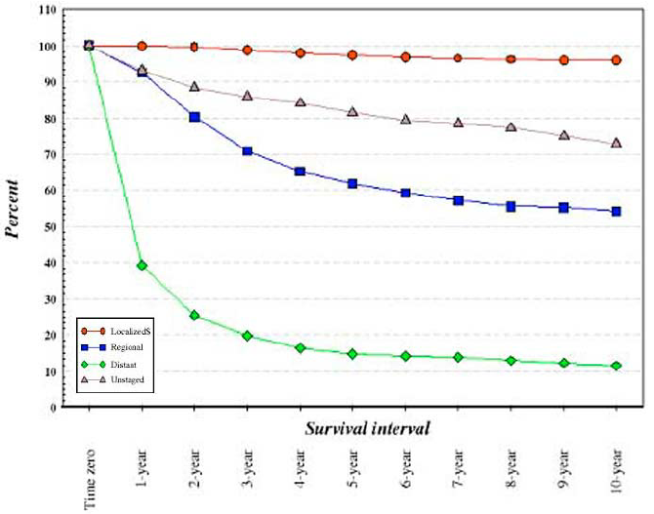
Background
According to the American Academy of Dermatology: *
Skin cancer is the most common cancer in the United States.
An estimated 1 in 5 Americans will be diagnosed with a form of skin cancer in their lifetime.
Nearly 20 Americans die from melanoma (the most common form of skin cancer) every day.
Early detection greatly increases survival rates among skin cancer patients.
*https://www.aad.org/media/stats-skin-cancer
AI tools have the potential to augment existing diagnostic methods and resources, increasing the number of cases that are identified before they become serious.
Melanoma Survival by Stage at Diagnosis
Source: The Current Epidemiology of Cutaneous Malignant Melanoma
(https://pubmed.ncbi.nlm.nih.gov/16368510/)

Slide 3
Problem Statement, Assumptions, and Hypothesis
The purpose of this project is to develop two Convolutional Neural Networks (CNNs) that can accurately distinguish between the 7 major types of skin lesions based on color image data.
Model #1: CNN designed and trained from scratch
Model #2: CNN leveraging pretrained model/transfer learning
Alternatively, this dataset could have been approached as a binary classification problem
The multiple classification problem was chosen based on the assumption that it would be more challenging
In production, the decision to use binary or multiple-classification would be determined by use-case
I hypothesize that the transfer learning model will quickly achieve reasonably accurate results, but that with a sufficiently deep/complex architecture and a large enough number of training epochs, the CNN trained from scratch will perform comparably.

Slide 4
Data Overview
The “HAM10000” dataset consists of 10,015 dermatoscopic images representing the 7 important diagnostic categories of pigmented skin lesions.*
Dataset was compiled by researched from 4 different sources, including several previously existing images sets.
Separate test dataset consists of 1,512 additional images.
Ground Truth for all observations was confirmed via traditional clinical methods (denoted by “dx_type” in metadata).
Both datasets are publicly available though Harvard Dataverse:
https://dataverse.harvard.edu/dataset.xhtml?persistentId=doi:10.7910/DVN/DBW86T
*Tschandl, P., Rosendahl, C. & Kittler, H. The HAM10000 dataset, a large collection of multi-source dermatoscopic images of common pigmented skin lesions. Sci Data 5, 180161 (2018). https://doi.org/10.1038/sdata.2018.16

Slide 5
Data Overview
Each dataset contains an associated metadata file that includes:
Lesion ID and Image ID
Diagnosis (dx)
Diagnosis Methodology (dx_type)
Patient Age
Patient Sex
Lesion Location on Body
Original Dataset (HAM100000 was compiled from 5 sources)
The Seven Categories of Diagnosis:
Actinic keratoses and intraepithelial carcinoma / Bowen’s disease (akiec)
Basal cell carcinoma (bcc)
Benign keratosis-like lesions; solar lentigines / seborrheic keratoses and lichen-planus like keratoses (bkl)
Dermatofibroma (df)
Melanoma (mel)
Melanocytic nevi (nv)
Vascular lesions; angiomas, angiokeratomas, pyogenic granulomas and hemorrhage (vasc)

Slide 6
Technical Infrastructure
Initial “shallow” CNN model was developed in local Jupyter notebook using 1,000 observation sub-sample.
Due to the size of the full dataset and the computational power required to train full-depth CNN, several cloud-based solutions were explored.
Ultimately settled on Google Cloud Compute Engine to create a Virtual Machine Instance:
200 GB of cloud storage
1x NVIDIA V100 GPU
Instance could be stopped when not in use, but would retain data when restarted
Provided greatly increased processing/computing power, while still keeping cost reasonable

Slide 7
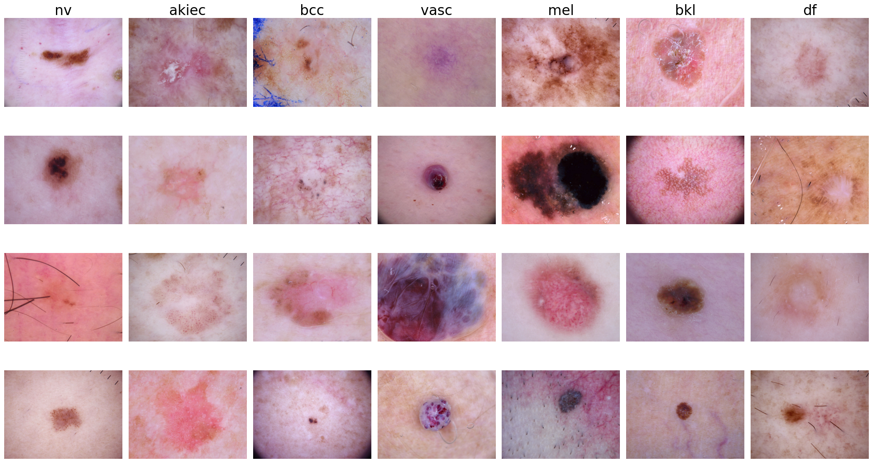
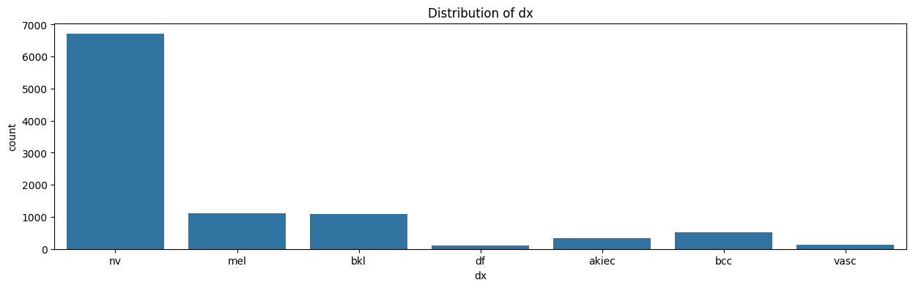
Exploratory Data Analysis
Classes are heavily imbalanced in favor of melanocytic nevi (nv)
Visually, each class shows a great deal of variation across a random sampling of images

Slide 8
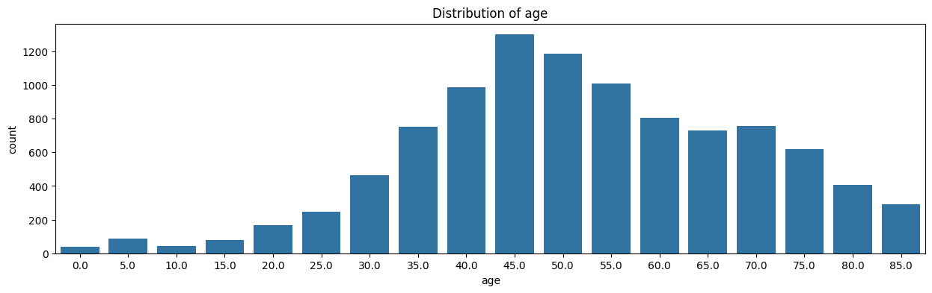
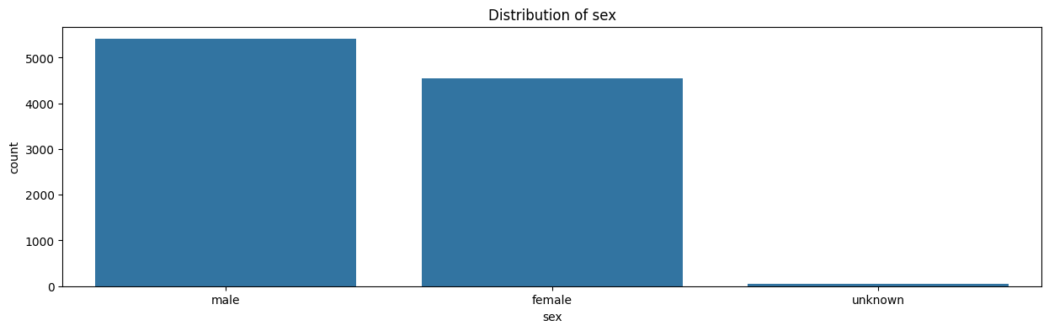
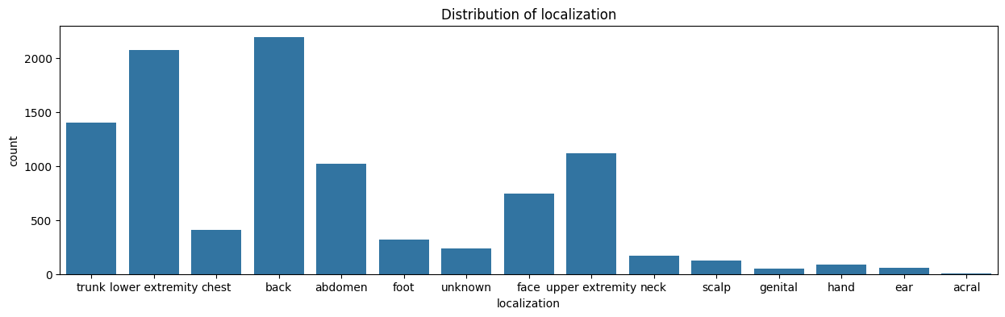
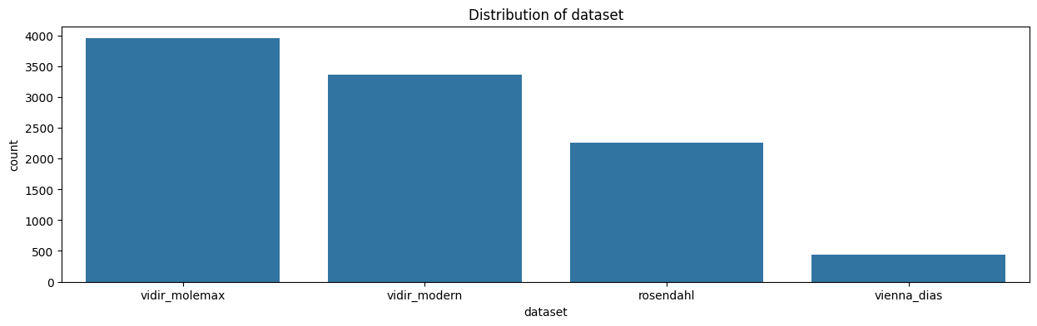
Exploratory Data Analysis - Metadata

Slide 9
Feature Engineering and Transformations (Data Augmentation):
Image data was organized into folders based on category/label, and imported using TensorFlow’s tf.data.Dataset object class as separate training and validation datasets.
The following transformation layers were built to include with each model:
Size and Scale:
Resize from 450x600 to 255x300
Rescaling (1./255)
Data Augmentation:
Random Flip
Random Rotation
Random Zoom
Random Contrast

Slide 10
Model Development:
A great variety of different architectures were explored for both the “from scratch” and transfer learning models (approximately 10+ variation each):
“From scratch” model began as simple “shallow” network (input layer, 2 convolutional layers, one dense layer, and output layer) and was gradually expanded until complexity reached the limits of available system resources.
Transfer learning models ranged from a single dense layer up to fully developed CNN architecture added after the pretrained ResNet50 model.
Combinations of the following regularization techniques were explored on each model:
Batch Normalization
Early Stopping
Dropout Layers
Learning Rate Adjustments
Both models were trained using a categorical cross entropy loss function and Adam optimizer.

Slide 11
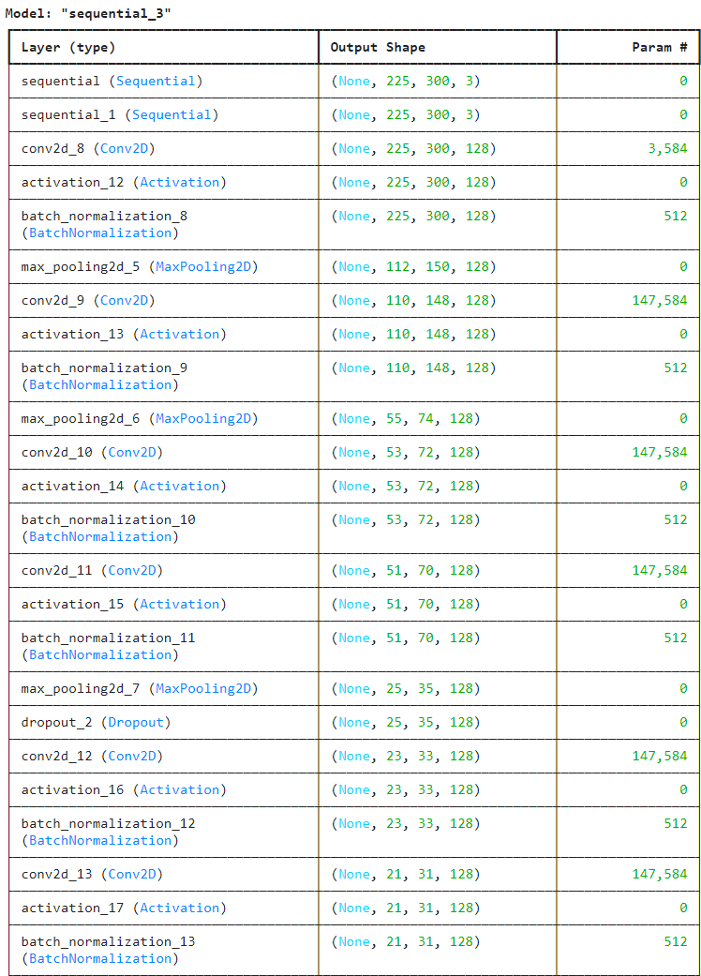
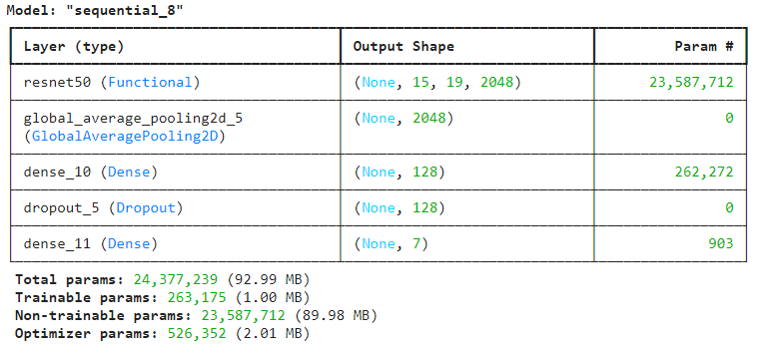
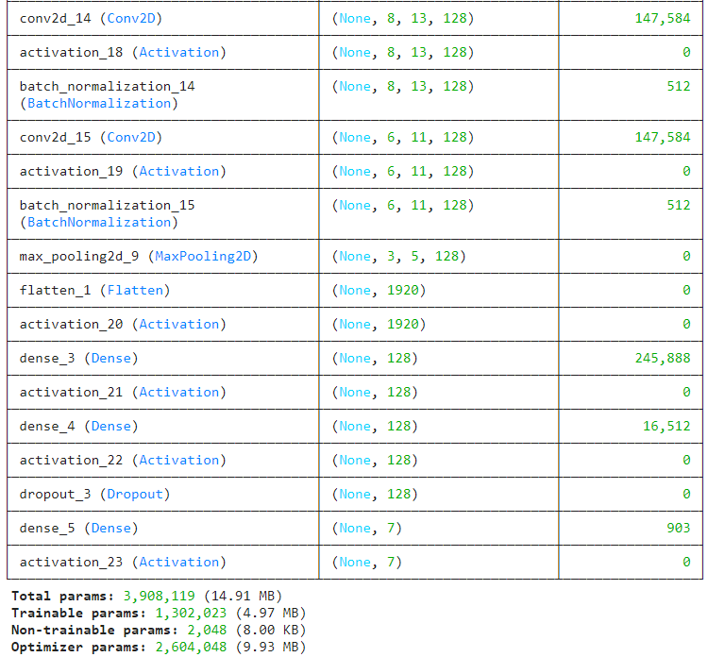
Model Architectures:
Trained From Scratch:
Transfer Learning:

Slide 12
Results
Model built from scratch benefitted greatly from increasingly complex model architectures and greater number of training epochs. Regularization methods prevented any serious overfitting, with only a modest loss of accuracy from training to validation data and from validation to test data.
Transfer learning model proved very prone to overfitting, and performed best with minimal layers built on top of the base model and no more than ~10 training epochs.
Performance of transfer learning model suffered when resizing/rescaling and data augmentation layers were applied (could not test “from scratch” model with full sized images due to system limitations).

Slide 13
Results
Final models of each type performed realtively similarly across training, validation, and test data:
Model/Accuracy | Training | Validation | Test | # Epochs
From Scratch | 85.40% | 78.85% | 72.17% | 40
Pretrained | 84.18% | 80.47% | 76.80% | 10

Slide 14
Results
(insert confusion matrices for both models)

Slide 15
Results
(show printout of predictions/class probabilities and actual diagnosis for sample of observations)

Slide 16
Future Work
Improve From-Scratch Model:
Increase Complexity (would require larger virtual machine):
Use full-sized images
Larger/deeper model (more layers)
Model Tuning:
Tune data augmentation layers
Alternate loss functions/regularization
Improve Transfer Learning Model:
Unfreeze 2-3 additional layers and retrain
Unfreeze whole model and train with very slow learning rate
Explore different base/pretrained models

Slide 17
Future Work
Address Data Imbalance:
Weighted Loss Functions:
Weighted Binary Cross-Entropy – Adjust influence of each class so that training does not focus only on most frequent categories
Focal Loss – Incentivizes model to focus training on hard-to-classify examples
Adjust Number of Observations:
Random Undersampling – Melanocytic nevi represented disproportional amount of dataset)
Synthetic Data Generation – Generative Adversarial Network (GAN)
Additional Models:
Binary Classification
Incorporate Metadata Information through Hybrid/Blended Model

Slide 18
Conclusions:
This dataset represents a very challenging classification task
As observed in exploratory analysis:
Significant variation exists within the examples of each category
Visual characteristics that can be shared across multiple categories
In practice, even highly trained dermatologists rely on clinical tools such as biopsy to confirm a diagnosis
Both transfer learning and training a model completely from scratch achieved ~ 75% accuracy predicting over 7 categories
While there are still meaningful opportunities to improve these models, even in their current state they could be useful tools to aid qualified medical professionals in the identification and diagnosis of skin cancer - with a proper understanding of their limitations.

Slide 19
Thank You

Slide 20
Appendix – Hybrid Model Proposed Architecture
Hybrid Model with Images and Tabular Data:
Build and train CNN with image data as before
Generate resultant dense representation
Build another neural network based on useful metadata columns:
Age
Sex
Localization
Combine both neural networks:
Concatenate resultant tensors from both models
Pass through softmax/output layer
* Credit: Stack Overflow

